Slide 1
The Basics of Service Learning
CTL Presentation
Rachel Holmes, M.Ed.
Faculty Service Learning Coordinator
EMCC

Slide 2
Preview of Today’s Session
Key Components of Service Learning
Getting Started: Faculty Directed vs. Student Directed Service Learning
Easy steps for implementation
Brainstorming SL Projects
Questions and discussion

Slide 3


Slide 4

What do you want to learn to today?
On a post-it, share out, review at the end of class

Slide 5
What is Service Learning?
Service Learning
  The combination of community service and classroom instruction, with a focus on critical, reflective thinking as well as personal and civic responsibility
  May be community service, one or more volunteer events, donations
Civic Engagement
    Active participation in the public life of a community in an informed, committed, and constructive manner with a focus on the common good
    Civic engagement provides students an opportunity to serve the community (the larger community or the college community) by working towards a long-term solution and/or awareness of an issue facing society
    Working towards positive social change

Slide 6
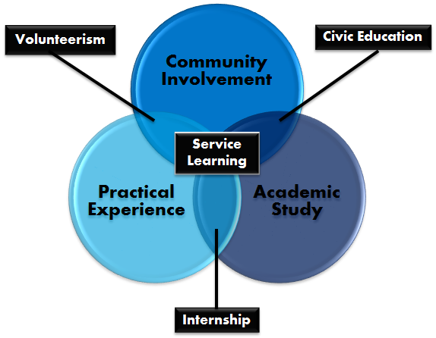

Slide 7

Key Components
Connecting Service with Learning
Reflection
Reciprocity
Critical Thinking
Social Responsibility
Experiential Learning

Slide 8

Key Component 1: Connecting Service with Learning
A successful SL project must include meaningful service and is directly tied to the course curriculum
    This service may be in the community or solely on the college campus
Impacts all stakeholders positively
Requires a final assessment/reflection
  Dual focus– the service and knowledge gained from that service

Slide 9

Key Component 2: Reflection
Reflection by the student is ongoing throughout the project

Slide 10

Key Component 3: Reciprocity
Service Learning makes it possible for the student to both give and to receive!
t/p/s
Imagine that you are volunteering in the local domestic violence shelter or the local food bank. What would you ‘receive’ from this experience?

Slide 11

Component 4: Critical Thinking
Service Learning allows the students to learn, volunteer, and work on a project that can and should facilitate reflective and analytical thinking.

Slide 12
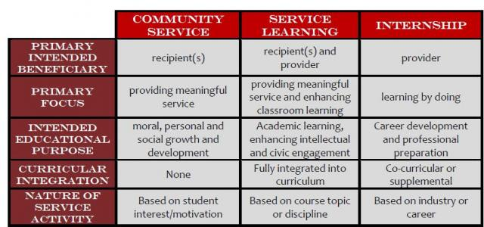

Slide 13
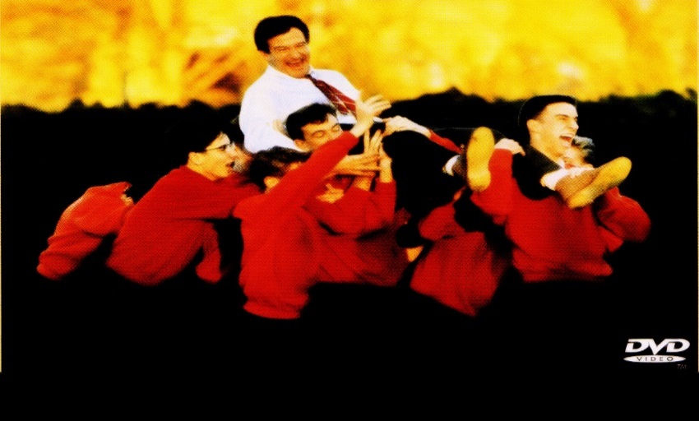
Two Avenues of SL
Faculty-Directed Service Learning
Instructor either assigns a specific project OR
Instructor provides a list of projects to choose from
Instructor oversees the student and project to ensure students are making progress and meeting academic requirements

Slide 14

Two Avenues for Service Learning
Student-Directed Service Learning
The students do the research to
identify a community need
Students develop their own project
complete with goal/outcome
statement, timeline, proposal
The instructor monitor’s student
progress but perhaps not quite as hands-on

Slide 15
Three Types of SL (Can be either Faculty-Directed or Student-Directed)
1.) Individual/Club Placements: Students/Clubs are placed at any of EMCC’s approved agencies. The student/club and agency will determine the goals of the service learning experience, number of hours and duration of the experience.
2.) Class Projects: Faculty (or a group of student from a specific class) may choose a project for their class at an agency that fits the course focus.
3.) One-Day Events: A one-day experience for students and faculty. This can be held on campus to benefit a specific agency/group of agencies or at the agency site.

Slide 16
Why are you here today?
Are you doing a class project, club project, or your own?
What questions do you have, and how can I assist?

Slide 17
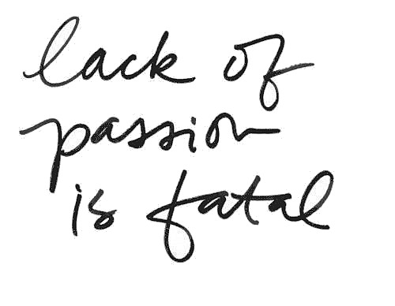
Do It Your Way!
Find your passion!
Determine how YOU would like to organize the SL projects
Start small
Don’t be afraid to try! (and learn from your mistakes)

Slide 18
Brainstorming Possible Projects
Work in small groups
Be prepared to share aloud
Think SERVICE, ACADEMIC RIGOR, and CREATIVITY

Slide 19
Next steps….
So based on what we’ve discussed today, where do you go from here?
Questions?

Slide 20
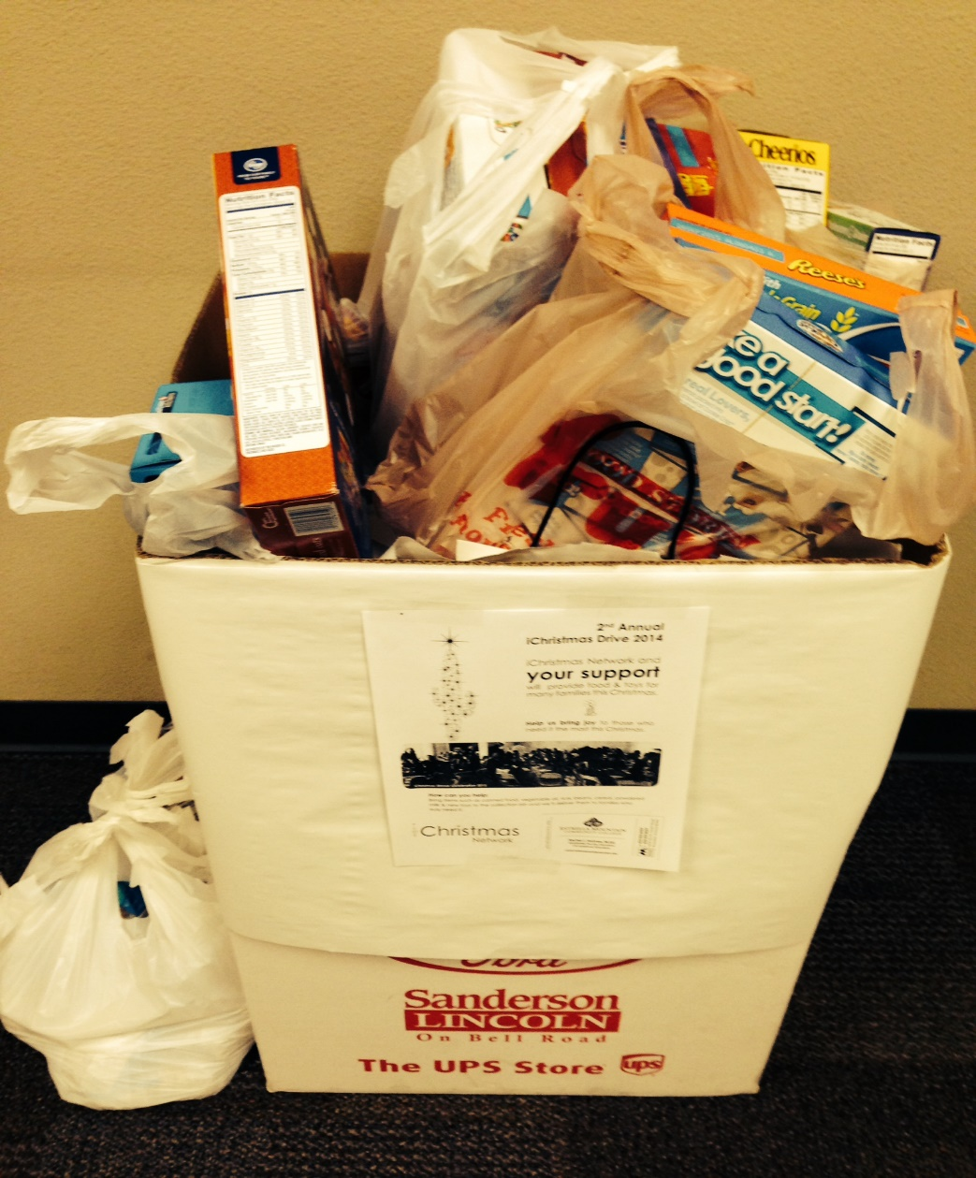
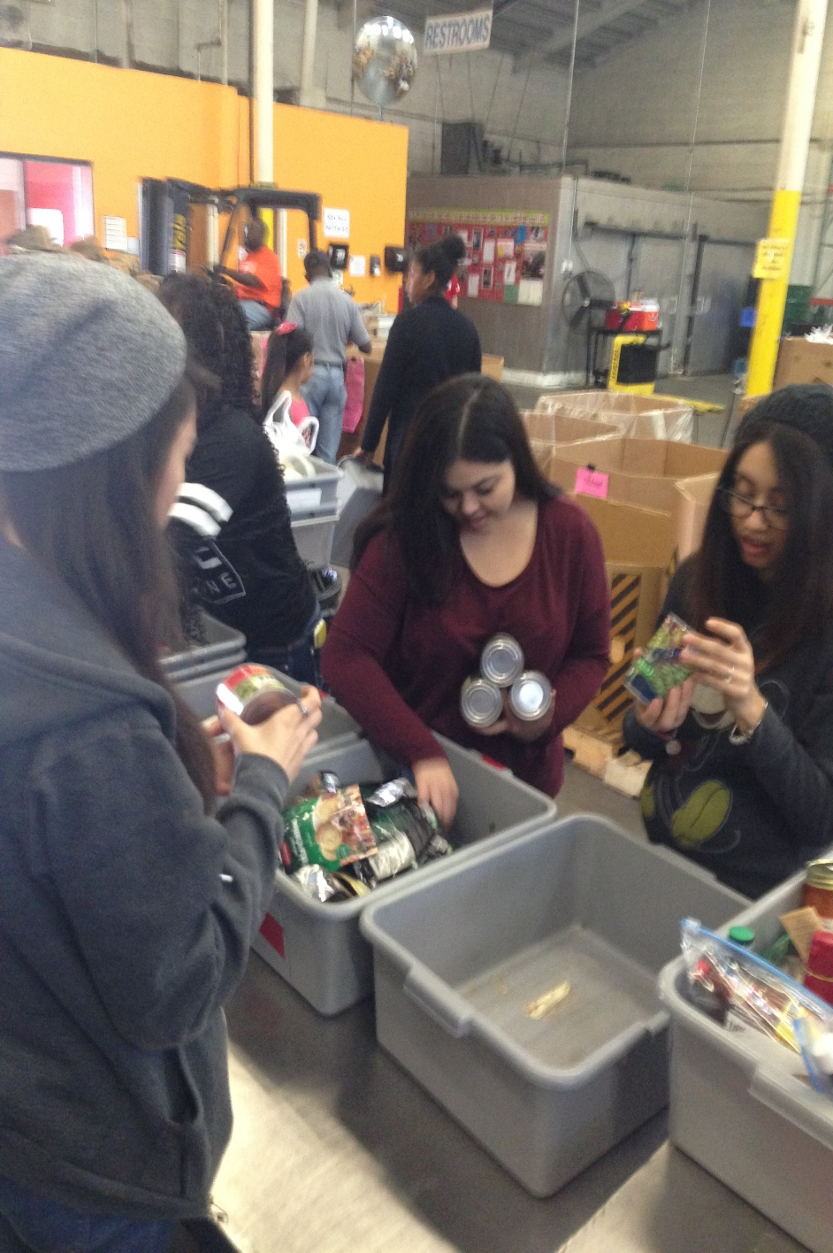
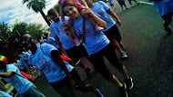

Slide 21
For Additional Assistance
Center for Service Learning and Civic Engagement
Located in the Career and Transfer Center
Faculty SL Coordinator- Rachel Holmes x58407
Rachel.Holmes@estrellamountain.edu
MAR108
SL Coordinator- Landis Elliott 623.935.8220
Landis.Elliott@estrellamountain.edu

