Slide 1
Center for
Service Learning
&
Civic Engagement
Landis Elliott & Rachel Holmes, SL Coordinators

Slide 2
Program Overview

Slide 3
Types of Experiential Education
Service Learning- Meaningful community service, connecting to classroom learning and includes a reflection.
Civic Engagement- Serving the community to take action by working towards a long-term solution and spreading awareness of an issue facing society.

Slide 4
Benefits
Builds community partnerships
Leads to greater student retention and degree completion
Provides real-life application of what students are learning in the classroom.
Provides an opportunity for students to learn about and give back to the community
Stimulates intellectual and leadership development
Helps prepare students for their future careers
Allows students to serve as involved citizens in their communities and heightens awareness of community needs
Develops critical thinking, communication, and problem-solving skills

Slide 5
2015-2016 Goals
F- 2014 6,189 hours
S- 2015 8,444 hours
21 instructors
                F- 2015 7,426 hours
                S- 2016 10,132 hours
                25 instructors
GOAL FOR THIS ACADEMIC YEAR
20% INCREASE
Fall 2015: Over 12,000 hours

Slide 6
Fall 2015/16 Accomplishments
1.) Marketing Materials
2.) Creation of Advisory Board
3.) Increased the number of Agencies
4.) Alternative Spring Break
5.) District-wide Service Learning
6.) Service Learning Celebration
7.) President’s Volunteer Service Award

Slide 7
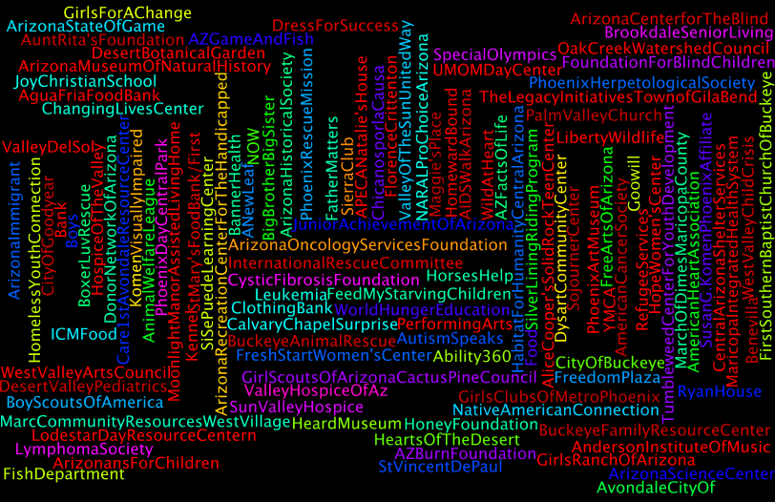

Slide 8
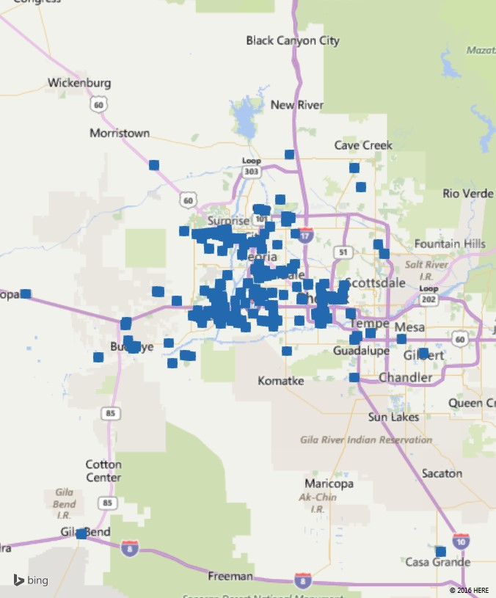
Service Learning Reach

Slide 9
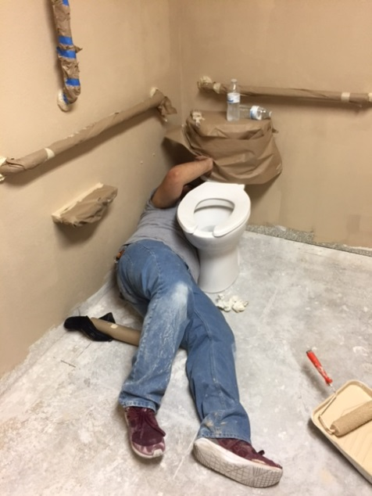
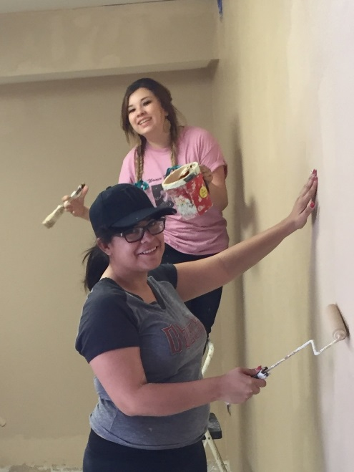
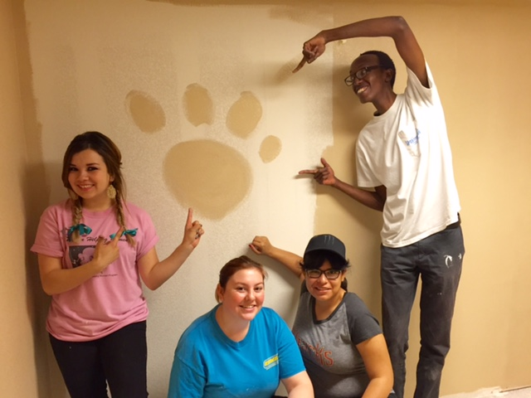
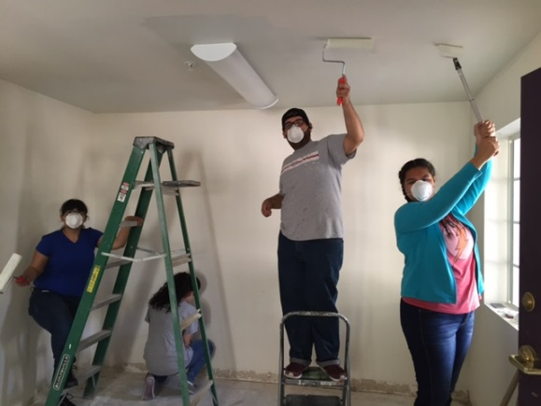
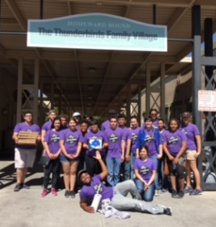
Alternative Spring Break
2016
Homeward Bound
30 Students (24 had no previous SL experience)
370 Hours

Slide 10
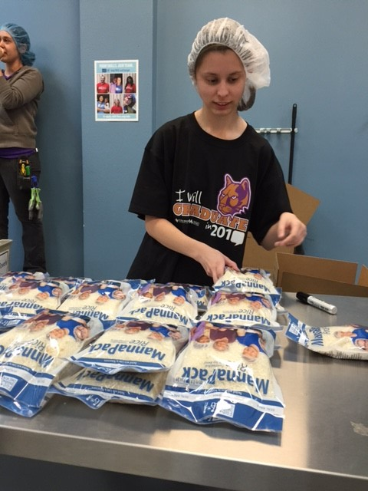
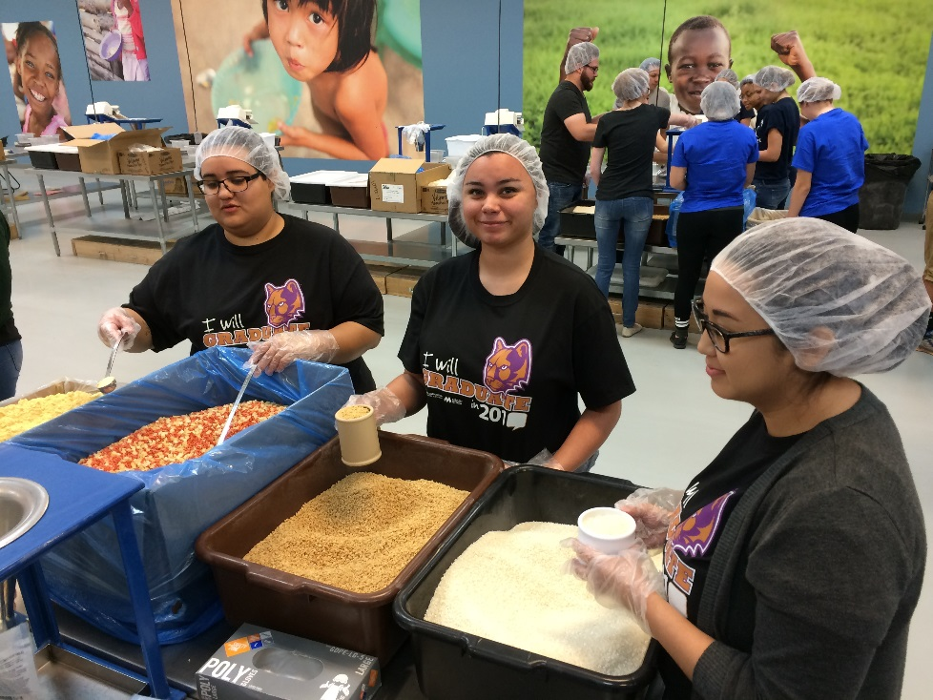
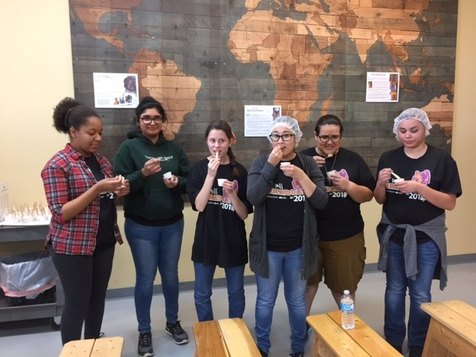
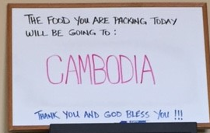
District-Wide Event
Feed My Starving
Children
Over 120 students participated

Slide 11
Fall 2015/16 Accomplishments
1.) Marketing Materials
2.) Creation of Advisory Board
3.) Increased the number of Agencies
4.) Alternative Spring Break
5.) District-wide Service Learning
6.) Service Learning Celebration
7.) President’s Volunteer Service Award

Slide 12
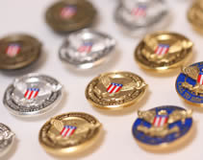

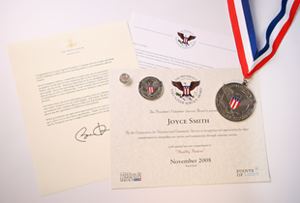
Presidential Community Service Award
Hours by Award | Bronze | Silver | Gold
Kids (5-10) | 26 – 49 | 50 – 74 | 75 +
Teens (11–15) | 50 – 74 | 75 – 99 | 100 +
Young Adults (16-25) | 100 – 174 | 175 – 249 | 250 +
Adults (26 and older) | 100 – 249 | 250 – 499 | 500+
Families and Groups* | 200 – 499 | 500 – 999 | 1,000+
President’s Lifetime Achievement Award: Individuals who have completed 4,000 or more hours in their lifetime
* Two or more people, with each member contributing at least 25 hours toward the total
60 students have received
this honor

Slide 13
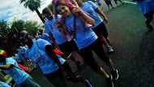
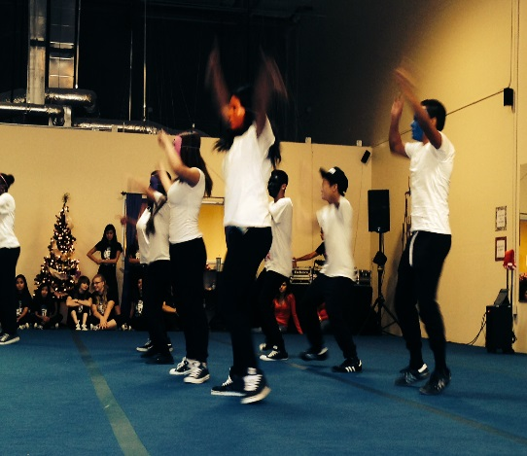
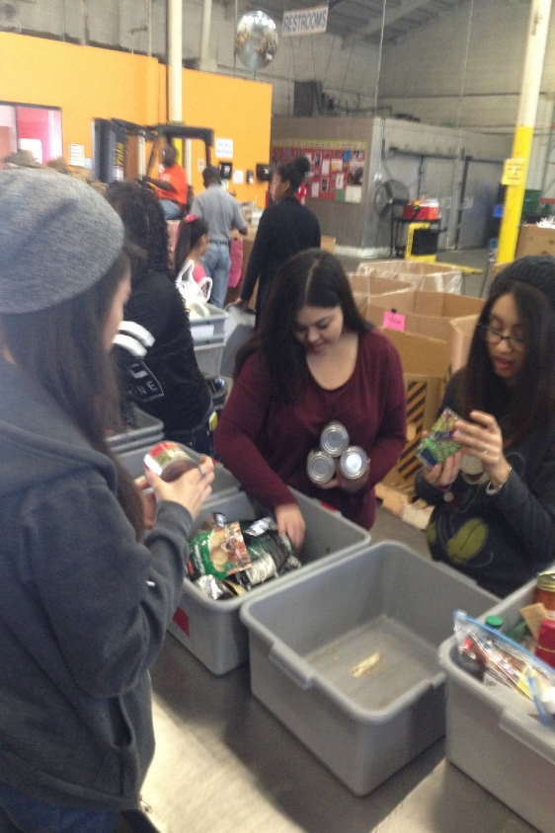
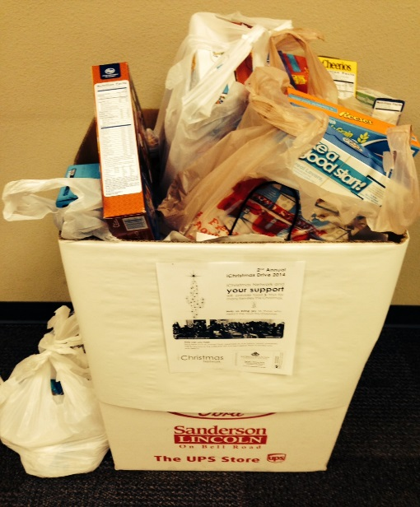
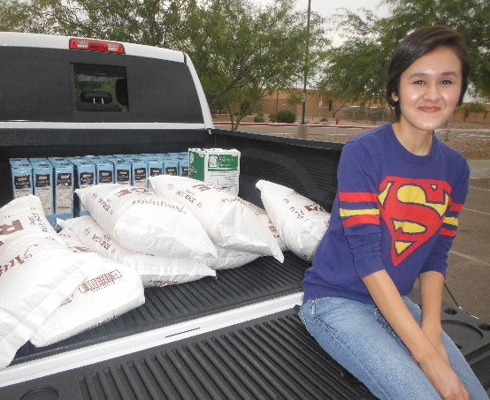
Service Learning Examples and Successes

Slide 14
Campus Events
Fall 2015
  Supporting the Veteran’s Run
  Supporting the United Way Committee – Food Drive
Spring 2016
  Alternative Spring Break with Homeward Bound- March 14th- 17th
  Feed Our Starving Children- April 1st
  Opportunity Fair- April 6th
  Service Learning Celebration- April 29th

Slide 15
We Need Your Support
Become a Service Learning Agency
Service Learning Advisory Board Member
Partner during on campus events such as the Opportunity Fair.

Slide 16
For More Information
Landis Elliott
Landis.Elliott@estrellamountain.edu
(623)935-8220
Rachel Holmes
Rachel.Holmes@estrellamountain.edu
(623)935-8407

