Slide 1
ASSESSMENT HAPPENS!
AGENDA for August 18th, 2016
2015- 2016 SAAC Members Shout Out!
They ”Took a Shot” at Assessment
Cats of the Month Share Out
CAT Scan
General Education Abilities Assessments
  Communication Information
  Communication Recruitment
Down and Dirty Cooperative Learning Strategies
Differentiated Assessment Workshop
  Data Use to Close the Loop (complete the cycle) – Norma Hernandez
  Learning Objectives Design for Probationary Faculty - Michelle Breaux and Pete Turner
  Open Workshop for CATS – Becky Baranowski
Assessment Olympics!
Lunch

Slide 2
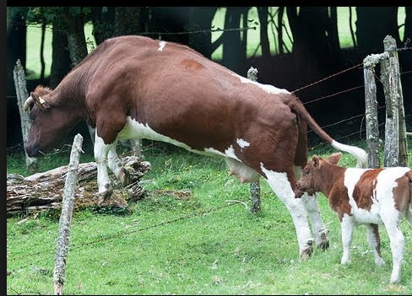
So . . .
Did you hear about the cow that jumped over the barbed wire fence?
It was udder destruction!

Slide 3
SAAC committee 2015-2016 shout out!
Valerie Akuna
Becky Baranowski
Jason Martinez
Patricia Cardenas-Adame
Kathleen Iudicello
Tanisha Maxwell-Johnson
Terry Meyer
Heather Muns
Bronwen Steele
Pete Turner
Olga Tsoudis
Jim Waugh
Rene’ Willekins

Slide 4
They Took a Shot at Assessment
Writing Composition
Social, Civic, Global Resonsibility
Inhye Peterson
Jessica Brown
Jim Cervin
Rachel Holmes
Erik Huntsinger
Kelly Loucey
Timothy McMichael
Jim Nichols
Bronwen Steele
Olga Tsoudis
Peter Turner
Becky Baranowski
Jessica Brown
Erik Huntsinger
Jim Nichols
Olga Tsoudis
Pete Turner
Roger Yaeger
Heather Muns
Rachel Holmes
Roselyn Turner
Voxi Amavilah
Tim McMichael
Bronwen Steele

Slide 5
CATS Of The Month share out
  January - Rachel Smith
  February – Olga Tsoudis
  March – Sylvia Ong
  April – Heather Muns
  May – Khalid Sandu
  June – Norma Hernandez (CATS of the Year)

Slide 6
CATS Scan
https://cats.estrellamountain.edu

Slide 7
General Abilities - Communication
Gen Ed Abilities Assessment Fall 2016
Two General Areas Measured
  Vocal Delivery
  Physical Delivery
Easy to Use Evaluation Form and Clear Rubrics developed by Communication Faculty Roselyn Turner and Cheri Hebert
Can be done any time throughout the semester
Will be sending out more information
Please Volunteer
1st Gen Ed Ability that will be in Cycle 3

Slide 8

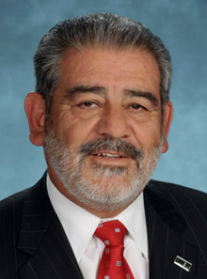
Communication – We Want You!**
**Disclaimer – Pete had
nothing to do with this

Slide 9
Down and Dirty Cooperative Learning Strategies
Johnson and Johnson Cooperative Learning
Institute
Why Cooperative Learning?
Luvia Rivera
Michelle Breux
Teri Graham
Becky Baranowski

Slide 10
Differentiated Assessment Workshop
Please self-select into one of three groups
  Data Use to Close the Loop (complete the cycle) – Norma Hernandez
  Learning Objectives Design for Probationary Faculty - Michelle Breaux and Pete Turner
  Open Workshop for CATS – Becky Baranowski

Slide 11
And now . . .
ASSESSMENT OLYMPICS!

Slide 12
Evaluation and Lunch
Ticket to lunch is your evaluation sheet

