Slide 1
ASSESSMENT MATTERS
THURSDAY, AUGUST 15TH, 2019

Slide 2



WELCOME BACK! FIRST DAY OF SCHOOL – WHICH ONE ARE YOU?

Slide 3


INTRODUCTIONS
Classroom Student Learning Outcomes Champions
Catherine Cochrane
Olga Tsoudis
Assessment Coordinators
Becky Baranowski
Roni Collazo
Student Affairs Champions
Catrina Kranich
Kristina Scott
Jake Ormond
Pattie Cardenas-Adame
Office of Planning and Institutional Effectiveness
Jim Waugh
Rene Willikens
You - Team Names

Slide 4

OUR ROLE
Facilitate, coordinate, and help align assessment at classroom, program, and institutional level
We support assessment activities with a goal to create a culture of student learning and continual improvement

Slide 5
OUR PURPOSE
Integration
Assessment Student Achievement
Analysis
Continuous Assessment
Notes:
Our purpose is from the Mission Statement

Slide 6
UPDATES
01
02
03
04
05
Student Academic Achievement Committee 🡪 Student Assessment Committee (SAC)
General Education Abilities 🡪 Institutional Level Learning Outcomes
Website
Excel Data Collection 🡪 Canvas
Classroom 🡪 Program 🡪 Institutional Level Learning Outcomes

Slide 7



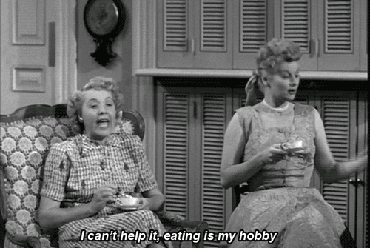

SNACKEONS AND LUNCHEONS
Classroom Conversations (luncheon) – Present and Discuss Institutional Learning Outcomes Data
Friday, August 30th from 12:00-1:30pm
Pedagogy Luncheon (luncheon) – Teaching and Assessment Tips
Thursday, October 3rd from 1:30-3:00pm
Understanding the Levels of Learning Outcomes (snackeon) – Course to Program to Institutional Level Learning Outcomes
Monday, August 26th from 1:00-2:00pm
Thursday, September 5th from 1:30-2:30pm
National Institution Learning Outcomes Assessment – Errin Haymen
Friday, September 20th (SA in morning and faculty in afternoon)

Slide 8
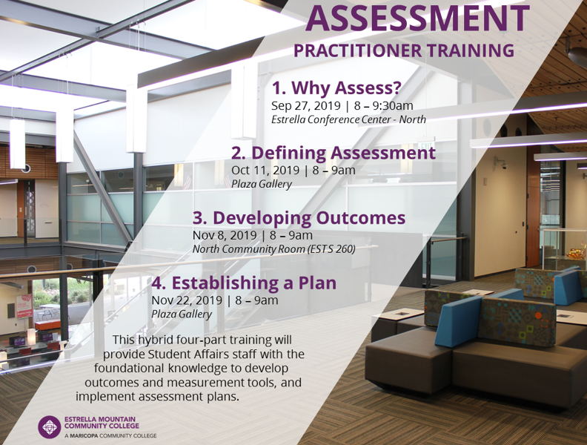
STUDENT AFFAIRS

Slide 9
POINTS OF CONTACT
Olga Tsoudis
EST N 262, X58592
Catherine Cochrane
KOM B 124, X58921
  BSCS
  A & C
  Modern Languages
  Instructional Computing
  Nursing
  Counseling
  Occupational Education
  Math
  Physical Sciences
  Life Sciences
  Information Resources

Slide 10

CLASSROOM STUDENT LEARNING OUTCOMES
Office of Institutional Effectiveness website
  Dashboards
    EMCC Student Learning Outcomes
      Login In

Slide 11
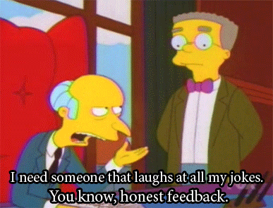


WEBSITE
Feedback Needed
https://www.estrellamountain.edu/employees/assessment

Slide 12
CANVAS
Institutional Level Learning Outcomes
Customized Rubrics
Import to Canvas and Specific Assignments

Slide 13

LET’S PLAY!
ARE YOU KOALA-FIED?

Slide 14
DEBRIEF
WHAT WAS THE POINT OF THIS?

Slide 15



THANK YOU!
Have a great semester
Roni Collazo
Becky Baranowski
OCT142
623-935-8983 (58983)
MON241
623-935-8596 (58956)

